Slide 1
Building a Typing Game

Slide 2
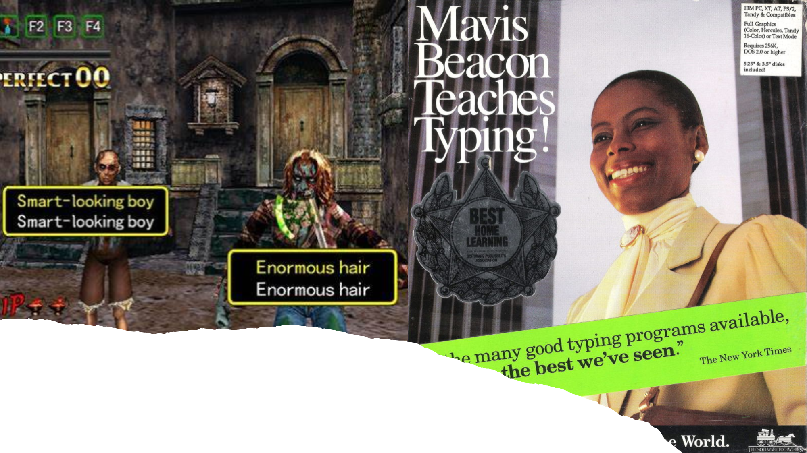
What are we going to build?
Notes:
Since the late 1980s typing games have been a fun way to help people of all ages learn how to type.
Most famously, Mavis Beacon taught typing to an entire generation of 1990s school kids.
The games are typing practice - typically displaying a word or phrase on the screen that the user has to “touch type” - typing without looking at the keyboard.
Practice makes perfect, and it was a good way to introduce skeptical computer users to typing for the first time.
While they may appear a strange form of entertainment, when trying to work out how to port their arcade game “The House of the Dead” in the 90s - a zombie shooter that used a light gun, Sega turned their game into the slightly hammy and hilarious “The Typing of the Dead” where you “shot” the zombies by typing the words that appeared next to them as the game played out in front of you. It was surprisingly addictive.
You’ll probably be mortified to hear that Mavis Beacon sadly is not a real person, and was fabricated for the game - the woman on the box is actually the fashion model Rennee L’Esperance.
I know. How could they lie to us like that.

Slide 3
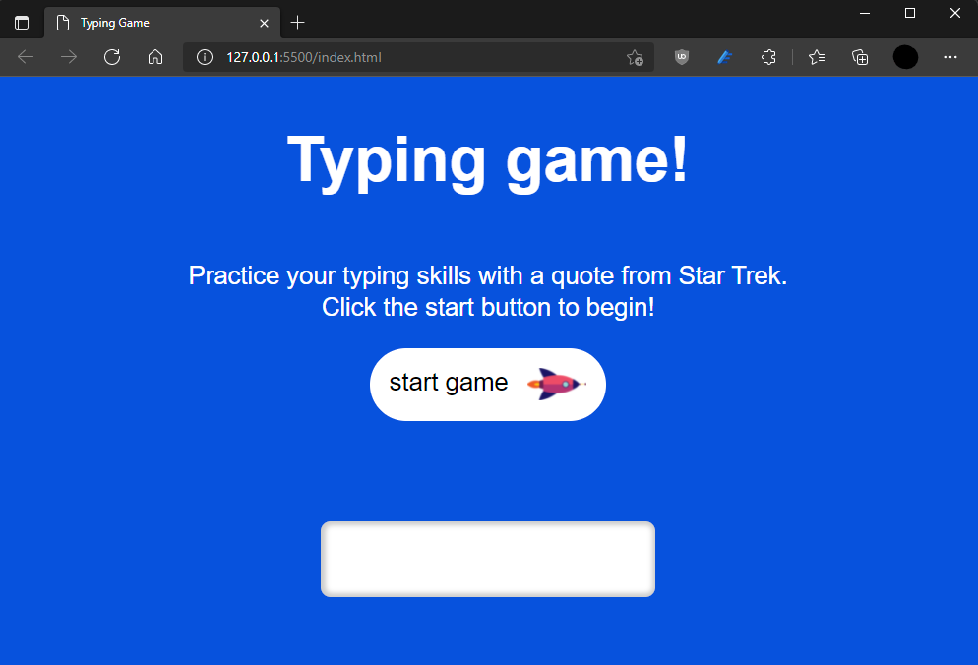

Slide 4
1.
Create the necessary files:
index.html script.js style.css
Notes:
Starter project available on Glitch here: https://fef-typing-game-starter.glitch.me/
Complete project available on Glitch here: https://fef-typing-game-complete.glitch.me/
Complete project available on GitHub here: snakemode/TypingGame (github.com)
Before we start, we’re going to need to create some empty files to work in.
If you’re in Visual Studio Code, you’ll need to create a new directory on your computer, and add three empty files - index.html, script.js and style.css.
You’ll need to install the plugin “liveserver” so that we can work on our game - you can do that from the Visual Studio Code extensions browser.
If you’d prefer to work in glitch, there’s a starter project pre-configured here Typinggame Starter (glitch.com) - the editor isn’t as good as in VSCode but it’s easier to get started.

Slide 5
Index.html - Add HTML boilerplate
<!DOCTYPE html>
<html lang="en">
<head>
<meta charset="utf-8" />
<meta name="viewport" content="width=device-width, initial-scale=1" />
<title>Typing Game</title>
<link rel="stylesheet" href="/style.css" />
<script src="/script.js" defer></script>
</head>
<body></body>
</html>
Notes:
Add empty boilerplate code
We’re going to start our game by adding some HTML boilerplate code that we’ll work inside of.
There is the usual doctype declaration, HTML tag, and head, with a title, a link to our CSS file, and a script tag pointing to our javascript file.
We have an empty body tag right now, but we’re going to add all of our markup in there as we go.
If you’re wondering what those “meta” tags are - they help our website run correctly on mobile devices.

Slide 6
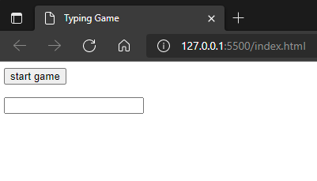
Index.html - Add HTML boilerplate
<body>
<button type="button" id="start" class="button">start game</button>
<p id="quote"></p>
<input type="text" id="typed-value">
</body>
Notes:
Add start game button
The first thing that we need to do is add our basic UI - user interface - elements.
We only really need a start game button, and an input text box for the player to type words into.
Let’s add three elements here - a button, with an id of “start” that we’ll use to find it in our javascript, and a class of “button” that we’ll use to style it up later.
A paragraph with the id quote - again so we can refer to it in our javascript, that we’ll use to put the text the user needs to type in
And finally an input box, with the id “typed-value” that we’ll use to see if the user typed the right thing or not.

Slide 7
script.js - Find the elements
const quote = document.getElementById('quote');
const input = document.getElementById('typed-value');
const start = document.getElementById('start');
function startGame() {
console.log("Game started!");
}
start.addEventListener('click', startGame);
Notes:
Use getElementById to grab our elements using the DOM.
Add empty startGame function.
Once we have our basic UI, we’re going to have to write some JavaScript code to build our game. This code is going to run as soon as our page finishes loading.
First, we’re going to define three constants - one for each of our UI elements. We’re using the DOM (the document object model) API here - that’s the functions that start with document-dot.
getElementById is one of the most common DOM functions you’ll see - you can use it to get a reference to a HTML element in your page by it’s ID - and that’s why we gave our UI elements id attributes.
Once we have those elements assigned to variables - quote, input and start, we can do things with them in our code.
Next, we’re defining a function called “startGame” (and just putting an unimportant console.log statement in it so we can make sure it’s called in our browser), and we’re using another function called “addEventListener”.
Your web browser “raises events” when different user interactions happen - you can add “event listeners” to practically any DOM element, so what our final line here is doing is saying “when the start element receives the event ‘click’, call the function startGame”. This is often described as “adding a click handler”, because our function “startGame” handles the “click” event.
With this chunk of code in our script.js file, when we click the button in our UI, we’ll see the message “Game started!” appear in our browsers debug console.

Slide 8
script.js - Add a target word and render it
const quote = document.getElementById('quote');
const input = document.getElementById('typed-value');
const start = document.getElementById('start');
let targetWord;
function startGame() {
console.log("Game started!");
targetWord = "typeme";
quote.innerHTML = `<span>${targetWord}</span>`;
}
start.addEventListener('click', startGame);
Notes:
When the game starts, we set a target word and add a <span> element to our document.
We’re going to start out by taking our game and breaking it down into the simplest thing it could possibly be.
A game where you have to type ONE SINGLE WORD to win!
Add a variable declaration just under our getElementById calls by typing “let targetWord;”
Then, in our start game function, we are going to assign that variable to the string value “typeme”.
It’s not a real word, but we’re just using it as test data for now.
Next, to make sure that the players know what word they need to type, we need to use JavaScript to update our UI.
To do this, we’re going to use a the property “innerHTML” on our `quote` paragraph that we previously used getElementById to find.
This property exists on all DOM elements, and when you set it, the contents of that element on the screen change.
We’re setting the innerHTML of our quote paragraph to a <span> element with our target word interpolated (that just means “put in the middle”) of it.
When this code runs, the web page will contain the original <p> paragraph tag, and inside of it our span, and inside of that our word.
Try it out! Click the button and see the word “typeme” appear on the screen.

Slide 9
script.js - Create check input function
...
quote.innerHTML = `<span>${targetWord}</span>`;
}
function checkInput() {
console.log("Checking", input.value);
}
start.addEventListener('click', startGame);
input.addEventListener('input', checkInput);
Notes:
Add an empty checkInput function and wire it up to the "input" event handler on the input box.
Next, we’re going to need to be able to check what the user has typed whenever the contents of our input box changes.
We can do this by adding another event listener on the event “input”, along with a function “checkInput” that we’ll call each time the contents of the input element changes.
We’re also just adding a console.log call into our new function so now, when you type in the text box after starting the game, you’ll see a log message in your browsers debug console.
Try it out now!

Slide 10
script.js - Add error indicators
function checkInput() {
const currentWord = targetWord;
const typedValue = input.value.trim();
if (currentWord !== typedValue) {
input.className = currentWord.startsWith(typedValue) ? "" : "error";
return;
}
}
Notes:
Add error indicator if you're typing the wrong word.
That’s all the “infrastructure” code we need - our whole game can work off those two event listeners.
Now, we’re going to add some logic to our checkInput function so that we can signal to the user when they’re typing the wrong thing.
We’re creating a variable called currentWord, and for the moment we’re just going to put our single targetWord into it.
Next, we use the property “value” on our input element, to get the contents of the text box, followed by a call to the function “trim()”;
Trimming the text removes any whitespace - literally empty spaces and tabs, from the start and end of a string. This means the variable typedValue will always be JUST the word the user has typed.
Now, if the currentWord (our target) does NOT EQUAL the value the user typed, we’re going to run an extra block of code to highlight the word that’s currently being typed incorrectly.
At the moment, this can obviously only be one word, but we’re going to expand on this later.
We’re going to highlight the word by adding the CSS class “error” to the span that the word is contained in, and to do this, we’re going to use the highlighted “ternary expression”.
Now that’s a complicated sounding thing, so let’s break it down.
We’re going to set the property “className” - which sets the CSS class name of an element to either an empty string “”, or the string “error”.
A ternary operator is just a shorthand for an if statement. The piece of code that comes before the question mark is the condition, and if it’s true, the output is the value after it, and if it’s false, the output is the value that comes after the colon.
So that one line of code reads “if the currentWord starts with the value typed in the text box, set the className to empty, otherwise, set it to error”.
This means that every single time the value of our textbox is modified, this code will check if the current typed value, is the start of the word we’ve asked our users to type, and if it isn’t, it’ll make sure that the CSS class “error” is set.
Why do we want to do this? Well...

Slide 11
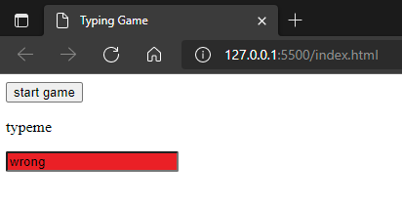
Style.css - Add error indicator
.error {
background-color: #EA2027;
}
Notes:
… we want to do this because we’re going to add a style to our style.css file to colour the input box in dark red if the user types the wrong thing.

Slide 12
script.js - Clear the textbox
function checkInput() {
const currentWord = targetWord;
const typedValue = input.value.trim();
if (currentWord !== typedValue) {
input.className = currentWord.startsWith(typedValue) ? "" : "error";
return;
}
input.value = ""; // empty textbox
}
Notes:
Clear the textbox if the word matches.
We’ve added code to handle errors, but we need to make sure we also know what to do if the word actually matches.
In our code, there’s a “return” statement if the word doesn’t match, that return statement stops our function from running any additional code if we know our word isn’t a match.
That means that any code we write after our if statement will ONLY RUN if the word we’ve asked for has been typed in correctly.
All we need to do is clear the input text box by setting its value property to an empty string “”;

Slide 13
script.js - Make a queue of words
let wordQueue;
function startGame() {
console.log("Game started!");
quoteText = "type me";
wordQueue = quoteText.split(' ');
quote.innerHTML = wordQueue.map(word => (`<span>${word}</span>`)).join('');
}
Notes:
Switch to a word queue to support multiple words.
It’s finally time to actually support more than one word in our game, and we need to make a couple of changes to make this work.
We’re going to use a JavaScript array to represent out list of words - and to do this, we’ll first rename our variable “targetWord” to “wordQueue”.
We’re using the word “queue” here, because we’re going to ask the users to type the words in the order they appear in the array - and in programming, treating an array like that is called a “queue” - just like in real life, the first thing that gets put into the queue, is the first thing that’s taken out of it. This is sometimes referred to as FIFO - which is just an abbreviation of “first in, first out”.
We need to assign an array to our word queue now instead of just setting it to the string “typeme”, and we’ll do this by first creating a string called `quoteText` which we’ll just set to “type me” - notice we’ve put a space in there, so it’s two words.
We’ll then convert that string to an array, by using the strings “split” function, passing an empty space as the argument.
Spit will take your string, and split it up into an array based on the argument you provide, so our string will get converted to an array with two elements, the word “type” and the word “me.
We could, right now, just write this array by hand (demo this if you like), but later on when we’re picking from entire sentences we’re going to need to use string split, so we may as well just do it now..
Now that we have our wordQueue, we’re going to need to fix up some of our other code that’s been broken by this change.
Because we no longer have a single string, we’re going to use the array function `map` to convert out entire queue of words into a series of span elements.
Map works a bit like a for loop, the callback function that we provide as an argument will be run for each item in our array, so the output of the map function call will be an array of strings.
Map will convert “type” and “me” to “<span>type</span>” and “<span>me</type>” (maybe type this out in front of the class instead of just reading it).
There’s one final wrinkle here - because innerHTML expects you to set it to a string, and we now have an array of span elements, we need to call the array function join - this will convert our array of spans into one long string. In the code here we’re passing the argument ‘’ (just two quotes) to the join call, which means that there will be no space between the strings when they are joined together.
That takes care of the word Queue, but we’re also going to have to change our checkInput function because there’s no longer just a string to compare the input to.
We only need to change two lines - instead of currentWord just being set to targetWord, we instead set it to the first element in our wordQueue array using an array indexer.

Slide 14
script.js - Make a queue of words
function checkInput() {
const currentWord = wordQueue[0];
const typedValue = input.value.trim();
if (currentWord !== typedValue) {
input.className = currentWord.startsWith(typedValue) ? "" : "error";
return;
}
wordQueue.shift(); //shift removes first item (0th element)
input.value = ""; // empty textbox
}
Notes:
Switch to a word queue to support multiple words.
It’s finally time to actually support more than one word in our game, and we need to make a couple of changes to make this work.
We’re going to use a JavaScript array to represent out list of words - and to do this, we’ll first rename our variable “targetWord” to “wordQueue”.
We’re using the word “queue” here, because we’re going to ask the users to type the words in the order they appear in the array - and in programming, treating an array like that is called a “queue” - just like in real life, the first thing that gets put into the queue, is the first thing that’s taken out of it. This is sometimes referred to as FIFO - which is just an abbreviation of “first in, first out”.
We need to assign an array to our word queue now instead of just setting it to the string “typeme”, and we’ll do this by first creating a string called `quoteText` which we’ll just set to “type me” - notice we’ve put a space in there, so it’s two words.
We’ll then convert that string to an array, by using the strings “split” function, passing an empty space as the argument.
Spit will take your string, and split it up into an array based on the argument you provide, so our string will get converted to an array with two elements, the word “type” and the word “me.
We could, right now, just write this array by hand (demo this if you like), but later on when we’re picking from entire sentences we’re going to need to use string split, so we may as well just do it now..
Now that we have our wordQueue, we’re going to need to fix up some of our other code that’s been broken by this change.
Because we no longer have a single string, we’re going to use the array function `map` to convert out entire queue of words into a series of span elements.
Map works a bit like a for loop, the callback function that we provide as an argument will be run for each item in our array, so the output of the map function call will be an array of strings.
Map will convert “type” and “me” to “<span>type</span>” and “<span>me</type>” (maybe type this out in front of the class instead of just reading it).
There’s one final wrinkle here - because innerHTML expects you to set it to a string, and we now have an array of span elements, we need to call the array function join - this will convert our array of spans into one long string. In the code here we’re passing the argument ‘’ (just two quotes) to the join call, which means that there will be no space between the strings when they are joined together.
That takes care of the word Queue, but we’re also going to have to change our checkInput function because there’s no longer just a string to compare the input to.
We only need to change two lines - instead of currentWord just being set to targetWord, we instead set it to the first element in our wordQueue array using an array indexer.

Slide 15
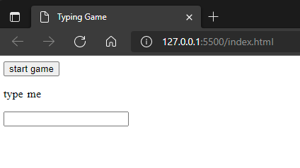
Style.css - Add spacing between words
span:after {
content: "";
display: inline-block;
width: 6px;
}
Notes:
With the changes in the last slide splitting up our words, there’s an interesting bug - there are no longer spaces between words in our UI!
We’re going to fix this by quickly adding a piece of CSS to add a space back in.
Here we’re using the psudoclass “after” - and this literally says “after every span on the page, add an empty string that’s six pixels wide”.
Now our words look like a sentence again.

Slide 16
script.js - Add highlighting
let wordQueue;
let highlightPosition;
function startGame() {
console.log("Game started!");
quoteText = "type me";
wordQueue = quoteText.split(' ');
quote.innerHTML = wordQueue.map(word => (`<span>${word}</span>`)).join('');
highlightPosition = 0;
quote.childNodes[highlightPosition].className = 'highlight';
}
Notes:
Add highlighting
So that the player knows which word they’re meant to be typing, we’re going to have to highlight the current word.
To do this, we’re going to add another variable called highlightPosition - this variable is going to track which word should be highlighted at any time. Just like we did with the error class, we’re going to apply a highlight by using CSS to set the background color of our highlighted word.
At the bottom of our startGame function we need to initialize the highlightPosition variable to 0, the first word.
Then, we’re going to use the DOM to set the CSS class name of the FIRST CHILD ELEMENT of our quote paragraph.
Remember, our “quote” element is just a paragraph, and inside it, when we set the innerHTML to a bunch of SPAN elements with each word.
That means that if we want to highlight the first word, we need to highlight the first span element inside our paragraph.
We’re using the property “childNodes” to do this, which is available on every dom element, and is a list of all of the HTML elements that are inside of it.
We can just use an array indexer again and then set the className to “highlight”.
In the starGame function, the highlightPosition is always going to be 0, the first word, bec

Slide 17
script.js - Add highlighting
function checkInput() {
const currentWord = wordQueue[0];
const typedValue = input.value.trim();
if (currentWord !== typedValue) {
input.className = currentWord.startsWith(typedValue) ? "" : "error";
return;
}
wordQueue.shift(); //shift removes first item (0th element)
input.value = "";
quote.childNodes[highlightPosition].className = "";
highlightPosition++;
quote.childNodes[highlightPosition].className = 'highlight'; }
Notes:
That code works for highlighting the first word when the game starts, but we also need to move the highlight when our players get a word right.
At the bottom of our checkInput function we need to add almost identical lines of code as in startGame.
First, we update the className on the currently selected highlightPosition to set it to empty (removing the highlight)
Then we use highlightPosition++ to increment the position - remember, the ++ operator just adds one to the current variable.
Then we use this new position to set the highlight class on the next word along.
The only thing we need to do now is add some CSS to our highlight class to make it look like something.

Slide 18
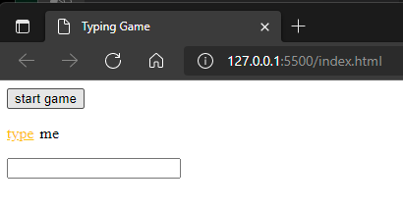
Style.css - Add highlighting
.highlight {
color: #FFC312;
text-decoration: underline;
}
Notes:
We’re going to add this highlight class to our style.css file. It’ll make the text yellow-ish, and underline the current word.

Slide 19
script.js - Add game over
function checkInput() {
const currentWord = wordQueue[0];
const typedValue = input.value.trim();
if (currentWord !== typedValue) {
input.className = currentWord.startsWith(typedValue) ? "" : "error";
return;
}
wordQueue.shift();
input.value = "";
quote.childNodes[highlightPosition].className = ""; // unhighlight word
if (wordQueue.length === 0) { // if we have run out of words then game over.
gameOver();
return;
}
highlightPosition++;
quote.childNodes[highlightPosition].className = 'highlight';
}
function gameOver() {}
Notes:
Add stub for game over function.
Now that we’ve updated our code to match words one by one as they appear in our wordQueue, we actually have a bug - if we run out of words, our code will break.
We’re going to need to add some code to end the game when the last word is removed.
Let’s add an if statement that checks if the number of items in our wordQueue becomes 0. If it does, we’ll call a new function called gameOver, and return from our checkInput function so we stop running anymore code.

Slide 20
Index.html - Show message on game over
<body>
<button type="button" id="start" class="button">
start game
</button>
<p id="quote"></p>
<p id="message"></p>
<input type="text" id="typed-value" />
</body>
Notes:
Show message on game complete.
Just calling gameOver is all well and good, but we should probably tell the user about it.
We’re going to add another element to our index.html file - an empty paragraph tag with the id of message.

Slide 21
script.js - Show message on game over
const quote = document.getElementById('quote');
const input = document.getElementById('typed-value');
const start = document.getElementById('start');
const message = document.getElementById('message');
...
Notes:
Show message on game complete.
We’re also going to add another variable at the top of our script.js file, to find our message element when the page loads.

Slide 22
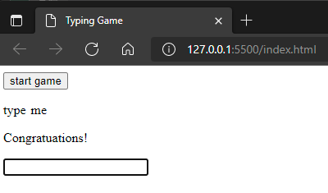
script.js - Show message on game over
function gameOver() {
message.innerHTML = `<span class="congrats">Congratuations!</span>`;
}
Notes:
And finally, we can add some code to our gameOver function to set the innerHTML of our message element when gameOver gets called - here we’re just adding a span with the message Congratulations! and giving it the css class congrats so we can style it later.
If you finish the game in your browser, you should see that message pop up now.

Slide 23
script.js - Add a time taken "score"
let wordQueue;
let highlightPosition;
let startTime;
function startGame() {
console.log("Game started!");
quoteText = "type me";
wordQueue = quoteText.split(' ');
quote.innerHTML = wordQueue.map(word => (`<span>${word}</span>`)).join('');
highlightPosition = 0;
quote.childNodes[highlightPosition].className = 'highlight';
startTime = new Date().getTime();
}
Notes:
Add a time taken variable to be used as a "score"
Now, our game wouldn’t be much of a game without some kind of scoring system, and the most obvious “score” for our game would be how long it takes to type a sentence.
Luckily, JavaScript has a Date object built in that’ll help us keep track of how long it takes to type all the words.
We need to introduce a new variable called startTime that we set when startGame is called.
To do that, we need to create a new Date() object (which when created is set to RIGHT NOW, and then call the getTime function on it, which returns a number.
That number, is the number of milliseconds since January 1st 1970, because computers are weird. January 1st 1970 is “the unix epoch” and you’ll see it everywhere in programming.
It doesn’t matter though, because to work out how long something has taken, we just need to do this again at the end of the game and subtract the first number from the second.

Slide 24
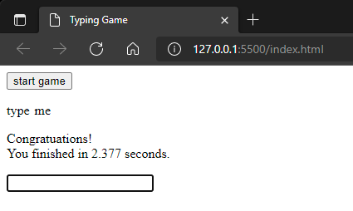
script.js - Add a time taken "score"
function gameOver() {
const elapsedTime = new Date().getTime() - startTime;
message.innerHTML = ` <span class="congrats">Congratuations!</span><br> You finished in ${elapsedTime / 1000} seconds.
`;
}
Notes:
Add a time taken variable to be used as a "score"
In our game over function, we need to add a bit of code to do just that. When the game ends, we call getTime on a new data, and subtract it from the startTime.
To get the number of seconds, we just divide THAT number by 1000 - here we’re doing that division when we interpolate elapsedTime into our string using the syntax ${elapsedTime / 1000} (dollar curley bracket, elapsed time divided by one thousand curley bracket) - when we’re creating strings that include variables using the dollar syntax, we can embed little bits of calculation like this.
Now, when our game ends, the total time taken is displayed!

Slide 25
script.js - Picking random quotes
const quotes = [
'Things are only impossible until they are not',
'It is possible to commit no errors and still lose. That is not a weakness. That is life',
'There is a way out of every box, a solution to every puzzle; it is just a matter of finding it.',
'Without freedom of choice there is no creativity',
'Logic is the beginning of wisdom, not the end',
'Improve a mechanical device and you may double productivity. But improve yourself, you gain a thousandfold',
'Compassion: that is the one thing no machine ever had. Maybe it is the one thing that keeps us ahead of them.',
];
const quote = document.getElementById('quote');
const input = document.getElementById('typed-value');
const start = document.getElementById('start');
...
Notes:
Picking different random quotes at the start of the game.
We’re almost through all the features of our game - the next thing we need to do is add different sentences that people can try type at random.
To start off with, we’re going to need a bunch of sentences to pick from, so we’re going to create a new array called quotes, and add a whole bunch of quotes into the text.
This can be anything, the more the better. We’re just going to put this array at the top of our file.

Slide 26
script.js - Picking random quotes
function startGame() {
console.log("Game started!");
const quoteIndex = Math.floor(Math.random() * quotes.length);
const quoteText = quotes[quoteIndex];
wordQueue = quoteText.split(' ');
quote.innerHTML = wordQueue.map(word => (`<span>${word}</span>`)).join('');
highlightPosition = 0;
quote.childNodes[highlightPosition].className = 'highlight';
startTime = new Date().getTime();
}
Notes:
Picking different random quotes at the start of the game.
Now that we have our set of quotes to pick from, we need to write some code to pick a random quote each time the game is started.
Randomness is JavaScript is slightly weird, but it’s all on this single line of code where we pick a “quote Index”.
What we’re doing, is we’re generating a random number with Math.random() between 0 and 1, then we’re going to multiply that number by the number of possible quotes.
This will give us a number between ZERO and the number of quotes in our list.
By calling Math.floor on this number, we get an index between 0 and the length of our array.
This is horrible and nobody ever remembers this, and it gets googled by everyone, every single time people need to get random numbers in JavaScript :)
BUT IT WORKS!
Once we have a valid random number for our quotes list, we use an array indexer again to set our quoteText variable to the randomly selected quote from our array.
Because all our other code works on that quoteText string, none of our other code has to change. How cool is

Slide 27
script.js - Clear the input & messages
function checkInput() {
const currentWord = wordQueue[0].replaceAll(".", "").replaceAll(",", "");
const typedValue = input.value.trim();
if (currentWord !== typedValue) {
….
Notes:
Remove punctuation when we're checking input so that it doesn't trip players up.
And finally, to make the game a tiny bit easier, we’re going to remove punctuation from our quotes by using the string.replaceAll function.
In our checkInput call, where we get the current word from the queue, we’re going to replaceAll occurrences of “.” (the full stop character) and all all instances of “,” (the comma character) with nothing.
This means that players won’t trip up on working out where to type punctuation while playing our game.
We don’t need to do this, but it was really annoying while we tested this exercise and it makes the game more fun!

Slide 28
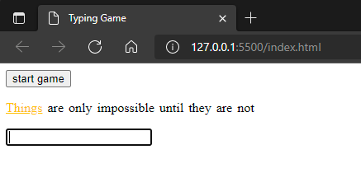
The game works but doesn’t look great!
Lets add some CSS to make it look good!
Notes:
And now we have a working, but roughly unstyled game!
[ Give everyone the opportunity to catch-up and make sure the game is working in their browsers here ]
Once we’re all happy with what we have, we’re going to style up the game to make it look more interesting!

Slide 29
script.js - Game win celebration
function startGame() {
...
document.body.className = "";
start.className = "started";
}
...
function gameOver() {
const elapsedTime = new Date().getTime() - startTime;
document.body.className = "winner";
message.innerHTML = ` <span class="congrats">Congratuations!</span> <br> You finished in ${elapsedTime / 1000} seconds.
`;
}
Notes:
Add confetti background when you win.
Let’s make the game over screen a bit more exciting.
We’re going to do that by adding a class to our body tag called “winner” when the gameOver function is called.
We’re also going to reset this class when we start a new game (along with adding a “started” class to our button).
You’ll notice because we know there is only one body tag in our document, we can access it directly by using the document.body property, and we don’t need to use getElementById like we did for our other elements.

Slide 30
script.js - Game win celebration
.winner {
background-image: url();
}
Notes:
Add confetti background when you win.
Next, we’ll add a .winner css class to our style.css file which adds a transparent background image of confetti to our game.

Slide 31
index.html - Add button icon
<button type="button" id="start" class="button">
start game <i class="rocket"></i>
</button>
Notes:
Add rocket button
We’re going to embed an <i> tag in our button that we can style up as a cute little rocket ship.
The I tag? Well - The <i> tag defines a part of text in an alternate voice or mood. It’s normally for italics, but we’ll use it here anyway - we just need an element to style up.

Slide 32
style.css - Add button icon
.rocket {
display: block;
width: 60px;
height: 34px;
margin-left: 20px;
background: url(imgurl) right center no-repeat;
background-size: 60px;
}
Notes:
Jumping back into our style.css file, we’re going to give our rocket some dimensions, and the background of a rocket ship.
background: url(https://cdn.glitch.com/fe55c52b-f859-4f17-a4c6-1af45426e959%2Frocket.png?v=1620489294028) right center no-repeat;

Slide 33
style.css - Add button icon
@keyframes shake {
0% { transform: translate(1px, 1px) rotate(0deg); }
10% { transform: translate(-1px, -2px) rotate(-1deg); }
20% { transform: translate(-3px, 0px) rotate(1deg); }
30% { transform: translate(3px, 2px) rotate(0deg); }
40% { transform: translate(1px, -1px) rotate(1deg); }
50% { transform: translate(-1px, 2px) rotate(-1deg); }
60% { transform: translate(-3px, 1px) rotate(0deg); }
70% { transform: translate(3px, 1px) rotate(-1deg); }
80% { transform: translate(-1px, -1px) rotate(1deg); }
90% { transform: translate(1px, 2px) rotate(0deg); }
100% { transform: translate(1px, -2px) rotate(-1deg); }
}
@keyframes zoomOutRight {
100% {
opacity: 0;
transform: scale(0.1) translate(500px, 0);
}
}
Notes:
Add rocket hover animation and slide out on click.
The CSS animation itself is declared as some key-frames - which we give the name “shake”.
The way keyframe animation works in CSS is you provide CSS transformation attached to each percentage of the runtime of an animation.
That means that the style that references the animation (in our previous slide), provides the time it takes to play, and each of these “key frame transformations” run as a percentage of that total execution time.
Our “animation” here is moving the image around by a few pixels on the x and y axis, and rotating it a degree and back again.
This means that when we hover over our rocket ship, it will “shake” a little in place.
Finally, we provide a second keyframe animation called “zoomOutRight” which plays when our “started” class is added.
This is a much simpler animation - it’s a transformation that moves the rocket 500 pixels to the right of our page when the animation is applied.

Slide 34
index.html - Add game instructions
<body>
<main>
<h1>Typing game!</h1>
<p>Practice your typing skills with a quote from Star Trek. <br>Click the start button to begin!
</p>
<button type="button" id="start" class="button">
start game <i class="rocket"></i> </button>
<p id="quote"></p>
<p id="message"></p>
<input type="text" id="typed-value">
</main>
</body>
Notes:
Add game instructions
To make our game accessible to players, we’re going to have to add some instructions for them to follow.
We’re just going to add a <main> section, along with a <h1> and a paragraph describing the game.

Slide 35
style.css - style the game
main {
display: grid;
place-items: center;
max-width: 640px;
margin: 0 auto;
line-height: 2rem;
}
h1 {
text-align: center;
font-style: normal;
font-weight: bold;
font-size: 4em;
line-height: 105%;
color: white;
}
p {
text-align: center;
font-size: 1.6em;
}
Notes:
Center the game and format the text nicely.
And with those elements added, we’re going to add some extra styles here to center the game in our browser.

Slide 36
style.css - style the game
body {
font-family: arial, helvetica, sans-serif;
background-color: #0652DD;
color: white;
}
button {
display: flex;
margin: 0 auto;
padding: 20px;
border: 0;
border-radius: 50px;
font-size: 1.6em;
background-color: white;
cursor: pointer;
overflow: hidden;
}
Notes:
Center the game and format the text nicely.
And with those elements added, we’re going to add some extra styles here to center the game in our browser.

Slide 37
style.css - style the game
input {
width: 300px;
padding: 20px;
font-size: 2em;
border: 0;
border-radius: 10px;
box-shadow: inset 1px 0px 5px 4px rgba(0,0,0,0.2);
}
.congrats {
text-transform: uppercase;
font-size: 3em;
font-weight: bold;
color: #FFC312;
}
Notes:
Style up the game
Let’s also add a style to the input element to make our input text box fit our slightly rounded edged theme.
We’ll add a border radius, some padding, and a shadow to make it look good.
And finally, let’s make that congratulations text uppercase, bold and golden, so our players know when they do REALLY well ;)

Slide 38
script.js - Reset the button animation
function startGame() {
console.log("Game started!");
...
startTime = new Date().getTime();
document.body.className = "";
start.className = "started";
setTimeout(() => { start.className = "button"; }, 2000);
}
Notes:
Re-set the rocket ship animation by resetting the button class.
To finish off our styling, we’re going to need to add a tiny bit of javascript to the end of our startGame function.
When we click the start button, our button gains the class “started”, which triggers the animation for the rocket ship to fly away.
If we want the rocket shit to RETURN for subsequent games, we need a way to set the class name back to “button”.
We’re going to use JavaScripts setTimeout function, which will run some of our code after a certain amount of time.
Here you can see we call setTimeout, passing an anonymous function as the first parameter, and 2000 as the second parameter (that’s 2000 milliseconds).
Our anonymous function sets the className of our start button back to “button” two seconds after it’s clicked.
This means when the player has finished one round, the animation will work correctly if they click the button

